Slide 1
FUNDAMENTALS OF SOFTWARE PROJECT MANAGEMENT
Scheduling
Week-9

Slide 2
Today
Network Fundamentals
Gantt Charts
PERT/CPM Techniques

Slide 3
WBS
Types: Process, product, hybrid
Formats: Outline or graphical org chart
High-level WBS does not show dependencies or durations
What hurts most ---- is -----what’s missing
Becomes input to many things, esp. schedule

Slide 4
Estimation
“The single most important task of a project: setting realistic expectations. Unrealistic expectations based on inaccurate estimates are the single largest cause of software failure.”
Futrell, Shafer, Shafer, “Quality Software Project Management”

Slide 5
Estimation
History is your best ally
  Especially when using LOC, function points, etc.
Use multiple methods if possible
  This reduces your risk
  If using “experts”, use two
Get buy-in
Remember: it’s an iterative process!
Know your “presentation” techniques

Slide 6
Your Early Phase Processes
Initial Planning:
    Why
      SOW, Charter
    What/How (partial/1st pass)
      WBS
      Other planning documents
        Software Development Plan, Risk Mgmt., Cfg. Mgmt.
Estimating
    Size (quantity/complexity) and Effort (duration)
    Iterates
Scheduling
    Begins along with 1st estimates
    Iterates

Slide 7
Scheduling
Once tasks (from the WBS) and size/effort (from estimation) are known: then schedule
Primary objectives
    Best time
    Least cost
    Least risk
Secondary objectives
    Evaluation of schedule alternatives
    Effective use of resources
    Communications

Slide 8
Scheduling Techniques
  Mathematical Analysis
    Network Diagrams
      PERT
      CPM
  Bar Charts
    Milestone Chart
    Gantt Chart
Notes:
Graphical Evaluation and Review Technique, commonly known as GERT

Slide 9
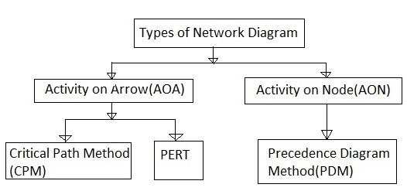
Network Planning Models
The project scheduling techniques model the project’s activities and their relationship as a network.
AOA approach is used to visualize the project as a network where activities are drawn as arrows joining circles, or nodes, which represent the possible start and/or completion of an activity or set of activities.
AON networks, activities are represented as nodes and links between nodes represent precedence (or sequencing) requirements. Majority of the computer applications use this method.
Notes:
ADM is also called the Activity on Arrow (AOA) method.
PDM is also known as the Activity on Node (AON) method.

Slide 10
Network Planning Models
Sequencing the tasks according to their logical relationship, and then scheduling them taking into account resources and other factor
Modeling the project’s activities and their relationship as a network
  Time flows from left to right
  Originally developed in the 1950’s
  Two best known: CPM and PERT

Slide 11
Network Planning Models
Activity-On-Arrow [1/2]
Used by CPM (Critical Path Method) and PERT (Program Evaluation Review Technique) to visualize the project as a network
  Activities are drawn as arrow joining circles, or nodes, which represent the possible start and/or completion of an activity or set of activities

Slide 12
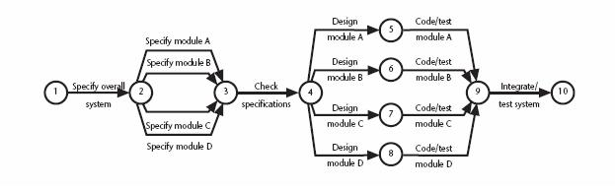
Network Planning Models
Activity-On-Arrow [2/2]
Project activity network fragment represented as a CPM network

Slide 13
Network Planning Models
Activity-On-Node [1/2]
Used by precedence networks
  Has become popular
  Widely adopted
Activities are represented as nodes
The links between nodes represent precedence (or sequencing) requirements

Slide 14
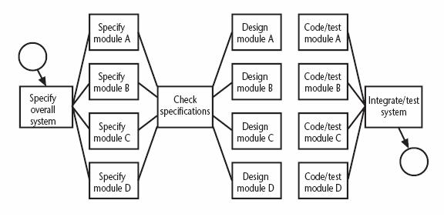
Network Planning Models
Activity-On-Node [2/2]
Fragment of a network developed as an activity-on-node network

Slide 15
Formulating A Network Model
Constructing Precedence Network Rules [1/2]
A project network should have only one start node
  More than one activity starting at once? Invent a ‘start’ activity with zero duration
A project network should have only one end node
  If necessary, invent an ‘end’ activity
A node has duration
Links normally have no duration

Slide 16
Formulating A Network Model
Constructing Precedence Network Rules [2/2]
Precedents are the immediate preceding activities
  All have to be completed before an activity can be started
Time moves from left to right
A network may not contain loops
A network should not contain dangles
  If necessary, connect to the final node

Slide 17
Terminology
Precedence:
    A task that must occur before another is said to have precedence of the other
Concurrence:
    Concurrent tasks are those that can occur at the same time (in parallel)
Leads & Lag Time
    Delays between activities
    Time required before or after a given task

Slide 18
4 Task Dependency Types
Mandatory Dependencies
    “Hard logic” dependencies
    Nature of the work dictates an ordering
    Ex: Coding has to precede testing
    Ex: UI design precedes UI implementation
Discretionary Dependencies
    “Soft logic” dependencies
    Determined by the project management team
    Process-driven
    Ex: Discretionary order of creating certain modules

Slide 19
4 Task Dependency Types
External Dependencies
    Outside of the project itself
    Ex: Release of 3rd party product; contract signoff
    Ex: stakeholders, suppliers, Y2K, year end
Resource Dependencies
    Two task rely on the same resource
    Ex: You have only one DBA but multiple DB tasks

Slide 20
[Project Start]
↓
[Requirements Gathering] (5 days)
↓
[Design Database] (7 days) ← Mandatory dependency
↓
├─→ [Code Backend API] (10 days) ← Can start after DB design
│
├─→ [Design UI/UX] (8 days) ← Concurrent with backend
│
└─→ [Get API Key from Google] (1 day) ← External dependency
↓
[Code Frontend] (12 days) ← Needs UI design (mandatory)
↓
[Integration Testing] (5 days) ← Needs both frontend & backend
↓
[Get Client Approval] (2 days) ← External dependency
↓
[Deploy to App Store] (1 day)
↓
[Project Complete]

Slide 21
Dependencies identified:
Mandatory: Database design before backend coding (can't code what doesn't exist)
Discretionary: Could do UI design before or after database design (team choice)
External: Waiting for Google API key approval
Resource: If same developer does both frontend and backend, creates resource dependency
Concurrence: UI design and backend coding happen in parallel
Lag time: 2-day app store review time before public release

Slide 22




Task Dependency Relationships
Finish-to-Start (FS)
  B cannot start till A finishes
  A: Construct fence; B: Paint Fence
Start-to-Start (SS)
  B cannot start till A starts
  A: Pour foundation; B: Level concrete
Finish-to-Finish (FF)
  B cannot finish till A finishes
  A: Add wiring; B: Inspect electrical
Start-to-Finish (SF)
  B cannot finish till A starts (rare)
Notes:
Start to finish - the duty officer of the current shift has to continue his job until the next shift duty officer started his job.

Slide 23
Lagged activities
Where there is a fixed delay between activities e.g. seven days notice has to be given to users that a new release has been signed off and is to be installed
Acceptance
testing
7days
Install new
release
20 days
1day

Slide 24
Types of links between activities
Finish to start
Start to start/ Finish to finish
Software
development
Acceptance testing
Test prototype
2 days
Document
Amendments
1 day
Notes:
Finish to start: The following activity starts when the previous one has been finished
e.g. testing starts when coding has been completed
Start to start: When one activity starts another has to start as well
e.g. when prototype testing starts amendment documentation has to start as well
Finish to finish: when one activity finishes the other must finish too
e.g. when the testing of the prototype is completed so is the documentation of any amendments
You could use these with lags e.g. documentation of the changes to the prototype starts 1 day after the testing and finishes 2 days after testing has been completed

Slide 25
Start and finish times
Latest
finish
Earliest start
activity
Latest start
Earliest finish
Activity ‘write report software’
Earliest start (ES)
Earliest finish (EF) = ES + duration
Latest finish (LF) = latest task can be completed without affecting project end Latest start = LF - duration
Notes:
The time that an activity can start depends on its relationship with the other tasks in the project. The earliest start is when the earliest of the preceding activities upon which the current activity depends will be completed, so that the current one can start. If it starts at this time the earliest the current activity can finish is the earliest start plus its duration.
However, it may be that the activity, although it can start, can be delayed because later activities do not have to start right way. This gives us a latest finish date. The latest start date is the latest finish date less the duration of the activity.
When a student is given coursework to do they do not necessarily start it straight away. They might note when it has got to be handed in, work out that it will only take about three days to do - with a bit of luck - and wait until three days before the hand-in before they start.

Slide 26
Terminology
Slack & Float
  Float & Slack: synonymous terms
  Free Slack
      Slack an activity has before it delays next task
  Total Slack
      Slack an activity has before delaying whole project
Notes:
“float” or “slack” is the amount of time a task can be delayed without affecting the deadlines of subsequent tasks or the project's final delivery date.

Slide 27
Example
earliest finish = ?
latest start = ?
earliest start = day 5
latest finish = day 30
duration = 10 days
What is it in this case?
EF=ES + Duration
LS= LF- Duration
Float = LF - ES – duration
OR
Float= LF - EF
Notes:
Note that Float can also be calculated as the difference between the earliest and latest start dates for an activity or the difference between the earliest and latest finish dates.
The earliest finish (EF) would be day 5 plus 10 days i.e. day 15.
The latest start (LS) would be day 30 – 10 days i.e. day 20
The float would be 30 – 5 – 10 = 15 days
This also is the same as LF – EF or LS - ES

Slide 28
Formulating A Network Model
Labelling Convention
There are a number of differing conventions that have been adopted
Example
Notes:
The activity span is the LF -ES

Slide 29
Adding The Time Dimension
The critical path approach
  Planning the project in such way that it is completed as quickly as possible
  Identifying delayed activities
The method requires the estimation of duration of each activity
  Forward pass: calculate the earliest dates at which activities may commence and the project completed
  Backward pass: calculate the latest start dates for activities and the critical path

Slide 30
Adding The Time Dimension
Example of Estimated Activity Duration of A Project
Activity |  | Duration (weeks) | Precedents
A | Hardware selection | 6
B | Software design | 4
C | Install hardware | 3 | A
D | Code & test software | 4 | B
E | File take-on | 3 | B
F | Write user manuals | 10
G | User training | 3 | E, F
H | Install & test system | 2 | C,D

Slide 31
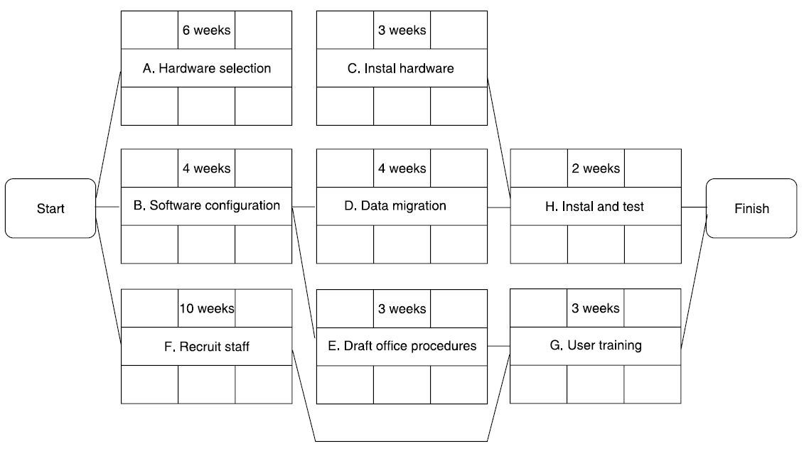
Adding The Time Dimension
The Precedence Network of The Example Project

Slide 32
Forward Pass
To determine early start (ES) and early finish (EF) times for each task
Work from left to right
Adding times in each path
Rule: when several tasks converge, the ES for the next task is the largest of preceding EF times

Slide 33
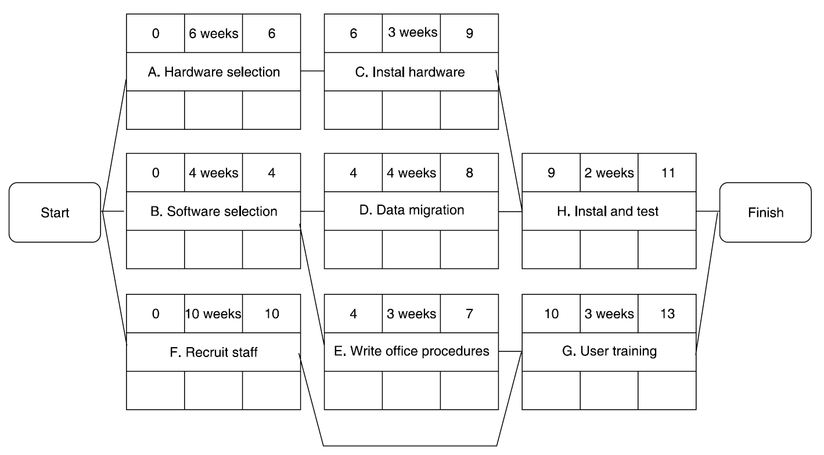
The Forward Pass
The Network After The Forward Pass

Slide 34
Backward Pass
To determine the last finish (LF) and last start (LS) times
Start at the end node
Compute the bottom pair of numbers
Subtract duration from connecting node’s earliest start time

Slide 35
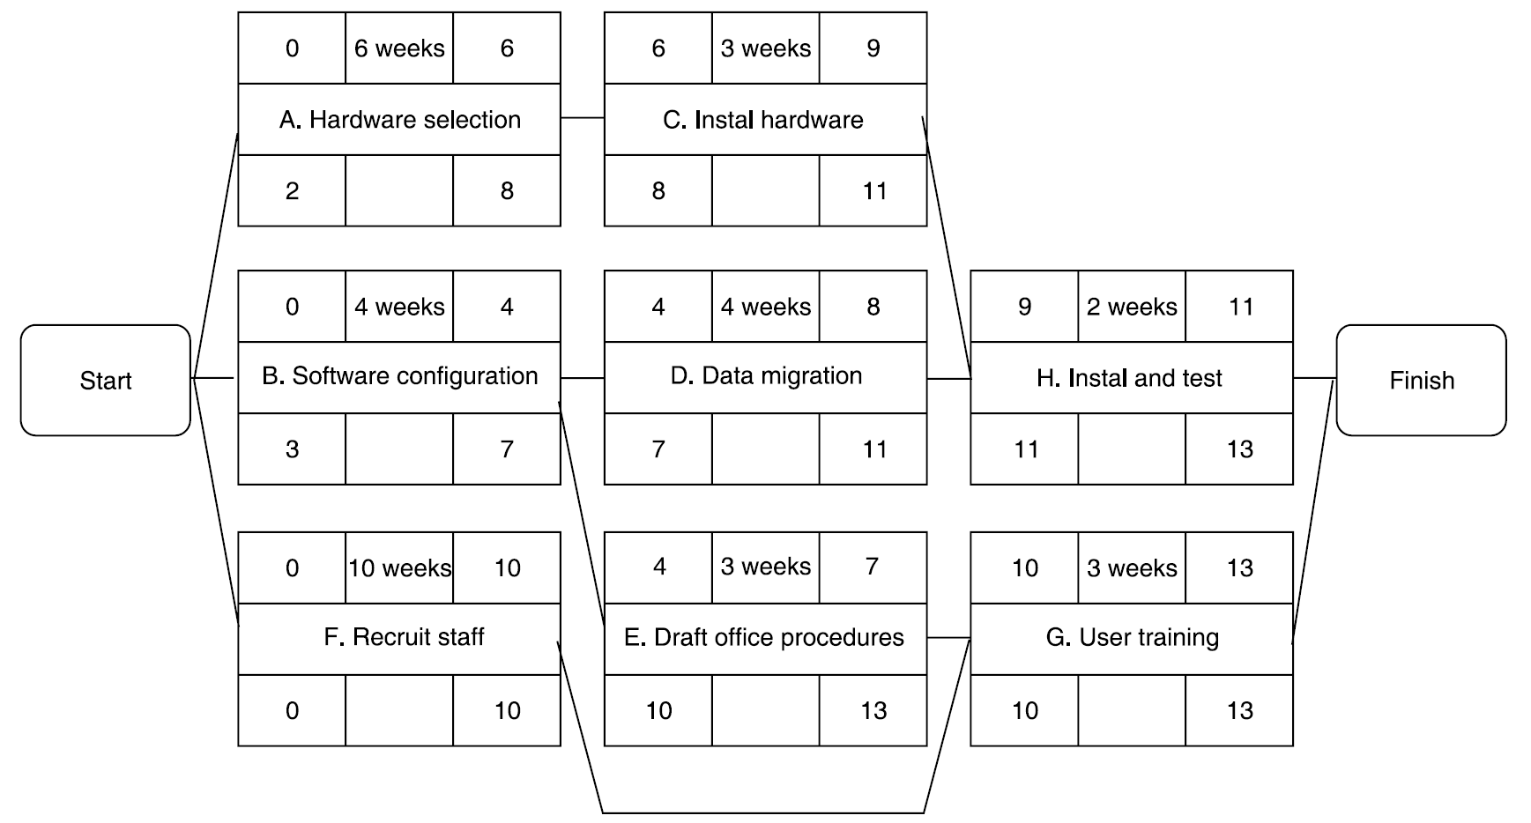
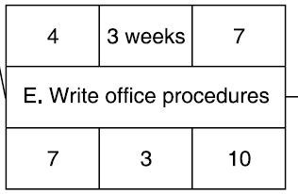
The Backward Pass
The Network After The Backward Pass

Slide 36
Critical Path Method (CPM)
  A critical path for a project is the series of activities that determine the earliest time by which the project can be completed.
  CPM is a network diagramming technique used to predict total project duration.
  The critical path is the longest path through the network diagram and has the least amount of slack or float.
  Slack or float is the amount of time an activity can be delayed without delaying a succeeding activity or the project finish date.

Slide 37
Calculating the Critical Path
  Develop a good network diagram.
  Add the duration estimates for all activities on each path through the network diagram.
  The longest path is the critical path.
  If one or more of the activities on the critical path takes longer than planned, the whole project schedule will slip unless the project manager takes corrective action.

Slide 38
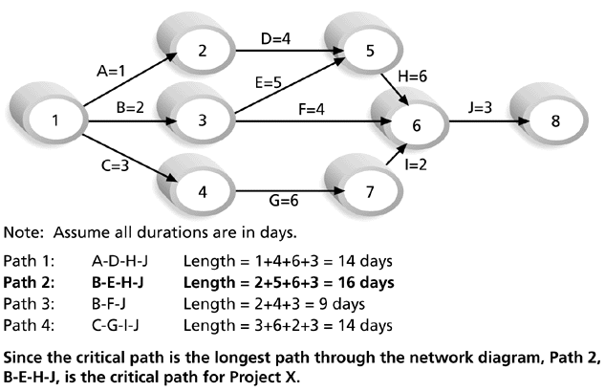
Figure 6-8. Determining the Critical Path for Project X

Slide 39
More on the Critical Path
  The critical path does not necessarily contain all the critical activities; it only accounts for time.
  There can be more than one critical path if the lengths of two or more paths are the same.
  The critical path can change as the project progresses.

Slide 40
Activity
A project consists of the following activities, with their respective durations and dependencies:
  Draw the network diagram using the Activity on Node (AON) method.
  Determine the critical path and the total project duration.
Activity | Description | Predecessor(s) | Duration (days)
A | Start Project | None | 3
B | Design Phase | A | 5
C | Development | B | 8
D | Testing | B | 6
E | Deployment | C, D | 4
F | Project Closure | E | 2

Slide 41
Activity
A project consists of the following activities, with their respective durations and dependencies:
  Draw the network diagram using the Activity on Node (AON) method.
  Determine the critical path and the total project duration.
Activity | Description | Predecessor(s) | Duration (days)
A | Site Preparation | None | 4
B | Foundation Work | A | 6
C | Frame Construction | A | 8
D | Electrical Wiring | B | 4
E | Plumbing | B | 5
F | Interior Finishing | C, D | 7
G | Roofing | C | 6
H | Landscaping | G | 5
I | Inspection | E, F, H | 3
J | Final Touches | I | 2

Slide 42
Activity-On-Arrow Networks
Originally used by CPM and PERT methods
Now less common than activity-on-node, still used and introduces an additional useful concept – that of events
Activities are represented by links (or arrows) and the nodes represent events

Slide 43
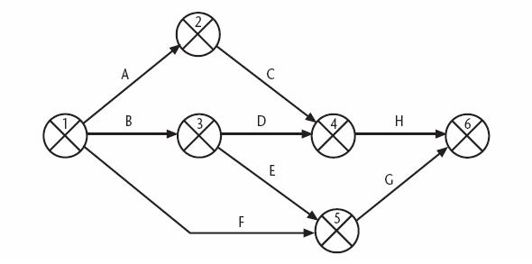
Activity-On-Arrow Networks
Activity-On-Arrow Network of the Example Project

Slide 44
Activity-On-Arrow Networks
Activity-On-Arrow Rules and Conventions [1/2]
A project network may have only one start node
A project network may have only one end node
A link has duration
Nodes have no duration
Time moves from left to right
Nodes are numbered sequentially

Slide 45
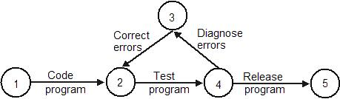
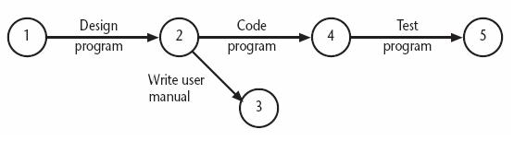
Activity-On-Arrow Networks
Activity-On-Arrow Rules and Conventions [2/2]
A network may not contain loop
A network may not contain dangle

Slide 46
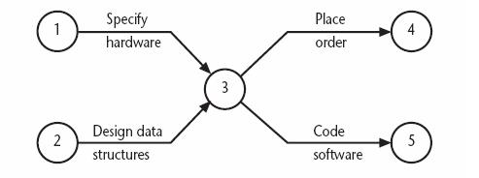
Activity-On-Arrow Networks
Using Dummy Activities [1/3]
A logical error occurs when two paths (‘specify hardware’ and ‘design data structure’) within a network have a common event although they are independent

Slide 47
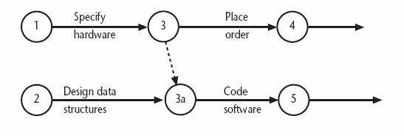
Activity-On-Arrow Networks
Using Dummy Activities [2/3]
Separating the two independent paths and introducing a dummy activity to link the completion of ‘specify hardware’ to the start of the activity ‘code software’

Slide 48
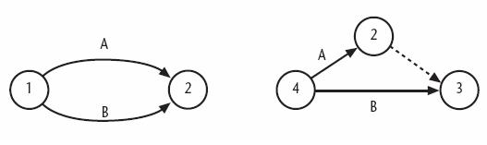
Activity-On-Arrow Networks
Using Dummy Activities [3/3]
Dummy activities, shown as dotted lines on the network diagram, have zero duration and use no resources
They are often used to aid in the layout of network

Slide 49
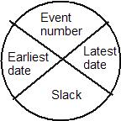
Activity-On-Arrow Networks
Activity Labelling
Typically the diagram is used to record information about the events rather than activities
One of the more common is to divide the node circle in quadrants

Slide 50
Activity-On-Arrow Networks
Network Analysis
Analysis proceeds in the same way as with activity-on-node networks
  The discussion places emphasis on the events rather than activity start and completion time
Stages
  The forward pass
  The backward pass
  Identifying the critical path

Slide 51
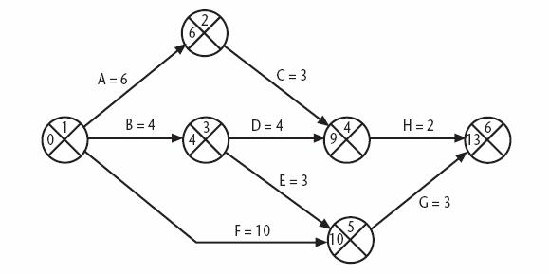
Activity-On-Arrow Networks
The CPM Network After The Forward Pass
Notes:
EF=ES+Duration

Slide 52
Activity-On-Arrow Networks
The Activity Table After The Forward Pass
Activity | Duration (week) | Earliest start date | Latest start date | Earliest finish date | Latest finish date | Total float
A | 6 | 0 |  | 6
B | 4 | 0 |  | 4
C | 3 | 6 |  | 9
D | 4 | 4 |  | 8
E | 3 | 4 |  | 7
F | 10 | 0 |  | 10
G | 3 | 10 |  | 13
H | 2 | 9 |  | 11
Notes:
EF=ES+Duration

Slide 53
Activity-On-Arrow Networks
The Backward Pass
Calculate the latest date at which each event may be achieved, each activity started and finished, without delaying the end of the project
The latest date for an event is the latest date by which all immediately following activities must be started for the project to be completed on time

Slide 54
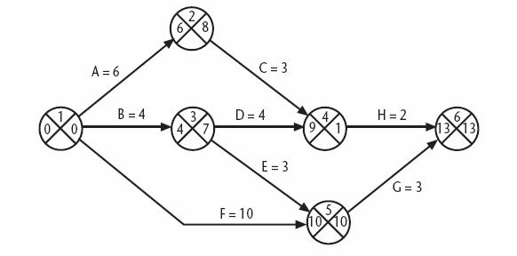
Activity-On-Arrow Networks
The CPM Network After the Backward Pass

Slide 55
Activity-On-Arrow Networks
The Activity Table After the Backward Pass
Activity | Duration (week) | Earliest start date | Latest start date | Earliest finish date | Latest finish date | Total float
A | 6 | 0 | 2 | 6 | 8
B | 4 | 0 | 3 | 4 | 7
C | 3 | 6 | 8 | 9 | 11
D | 4 | 4 | 7 | 8 | 11
E | 3 | 4 | 7 | 7 | 10
F | 10 | 0 | 0 | 10 | 10
G | 3 | 10 | 10 | 13 | 13
H | 2 | 9 | 11 | 11 | 13
Notes:
LS=LF – Duration
Total Float/Slack= LF-EF OR LS - ES

Slide 56
Activity-On-Arrow Networks
Identifying The Critical Path
The critical path is identified in a way similar to that used in activity-on-node networks
A different concept is used: slack
A slack is the difference between the earliest date and the latest date for an event
  It is a measure of how late an event may be
Notes:
Critical path == path that contain slack with 0 value OR Longest path (total max duration) from all the possible path.

Slide 57
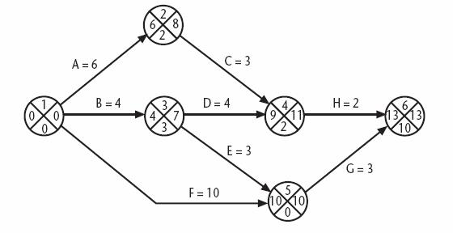
Activity-On-Arrow Networks
The Critical Path
The critical path is the path joining all nodes with a zero slack
Notes:
Slack = Latest –Earliest

Slide 58
Network Diagrams
Advantages
  Show precedence well
  Reveal interdependencies not shown in other techniques
  Ability to calculate critical path
  Ability to perform “what if” exercises
Disadvantages
  Default model assumes resources are unlimited
    You need to incorporate this yourself (Resource Dependencies) when determining the “real” Critical Path
  Difficult to follow on large projects

Slide 59
Program Evaluation and Review Technique (PERT)
  PERT is a network analysis technique used to estimate project duration when there is a high degree of uncertainty about the individual activity duration estimates.
  PERT uses probabilistic time estimates:
      Duration estimates based on using optimistic, most likely, and pessimistic estimates of activity durations, or a three-point estimate.

Slide 60
PERT
Program Evaluation and Review Technique
Based on idea that estimates are uncertain
  Therefore uses duration ranges
  And the probability of falling to a given range
Uses an “expected value” (or weighted average) to determine durations

Slide 61
PERT Formula and Example
PERT weighted average =
  optimistic time + 4X most likely time + pessimistic time
  6
Example:
  PERT weighted average =
  8 workdays + 4 X 10 workdays + 24 workdays = 12 days 6
  where:
  optimistic time= 8 days
  most likely time = 10 days
  pessimistic time = 24 days
  Therefore, you’d use 12 days on the network diagram instead of 10 when using PERT for the above example.

Slide 62
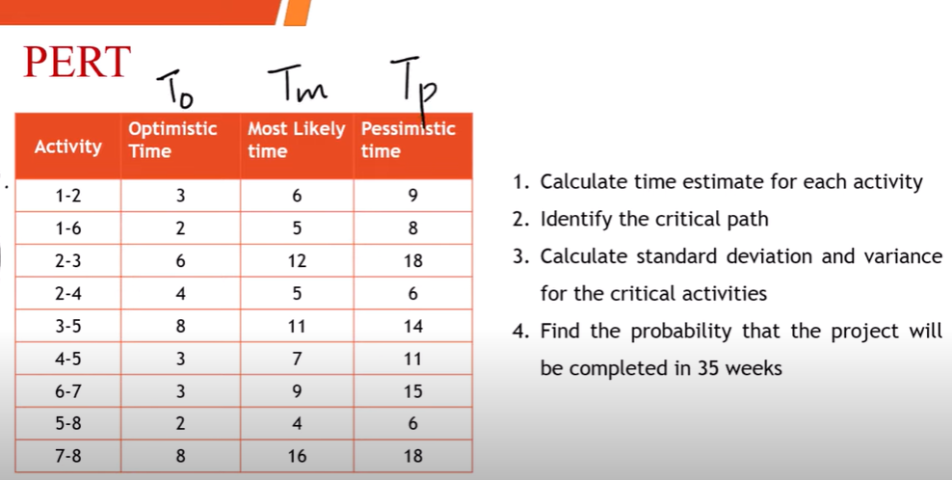
Example-Solved
Steps to solve PERT

Slide 63
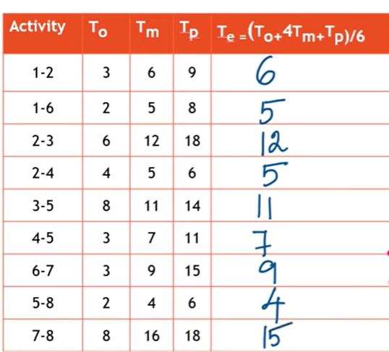
Step1: Calculate Estimated Time

Slide 64
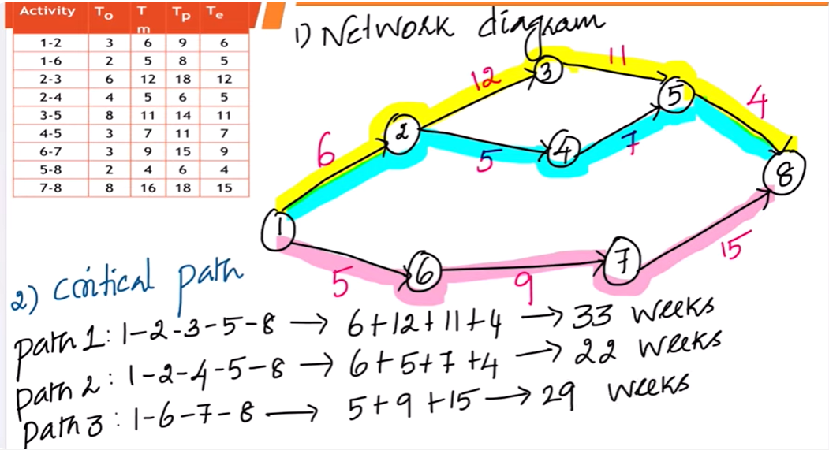
Step2- Identify Critical Path

Slide 65
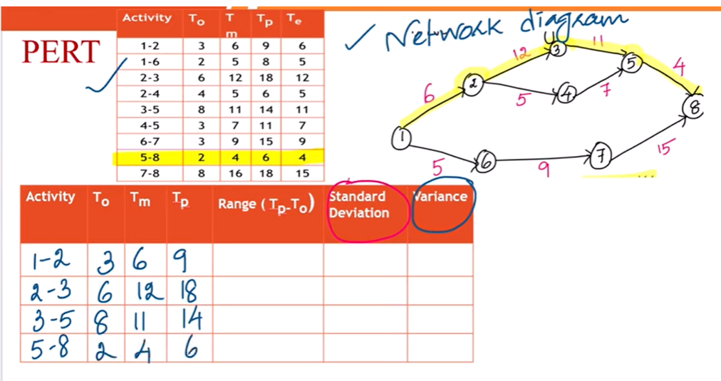
Step 3: Use critical path activities to Calculate SD and Variance

Slide 66
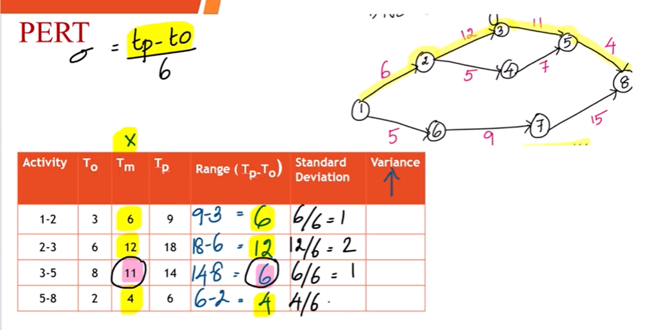
Step 3: Continue…

Slide 67
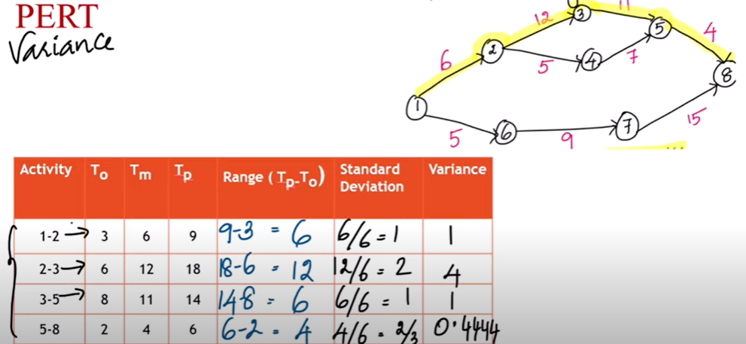
Step 3: Continue…

Slide 68
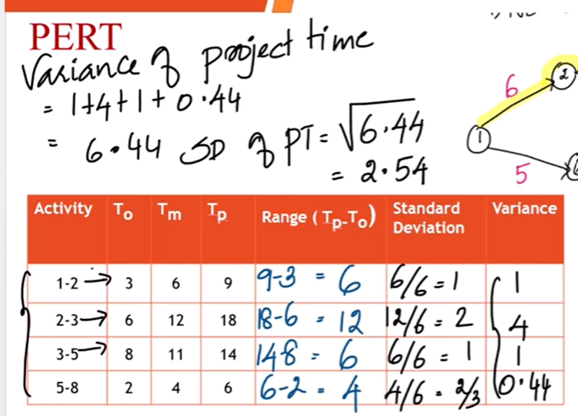
Step3 (Continue): Variance and SD of Project Time

Slide 69
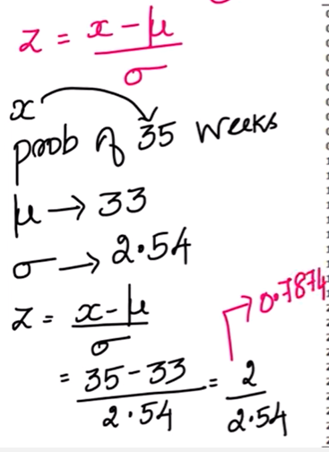
Step 4: Calculate Probability

Slide 70
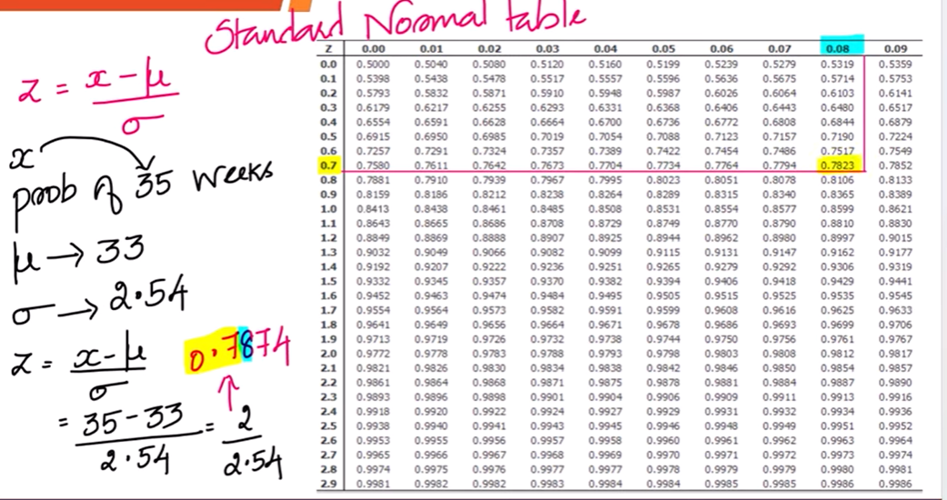
Step 4 (Continue): Finalize Probability through Z-Table/Standard Normal Table

Slide 71
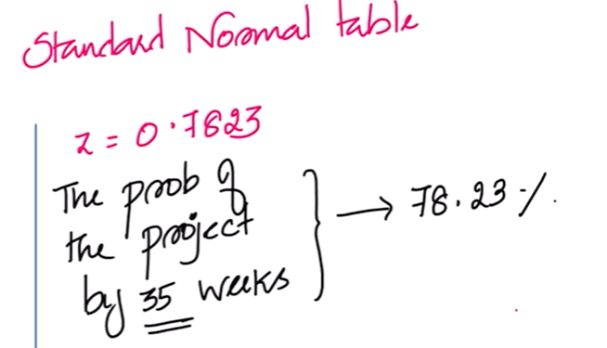
Step 4 (Continue): Final Probability

Slide 72
CPM vs. PERT
Both use Network Diagrams
CPM: deterministic
PERT: probabilistic
CPM: one estimate, PERT, three estimates
PERT is infrequently used

Slide 73
Milestone Chart
Sometimes called a “bar charts”
Simple Gantt chart
  Either showing just highest summary bars
  Or milestones only

Slide 74
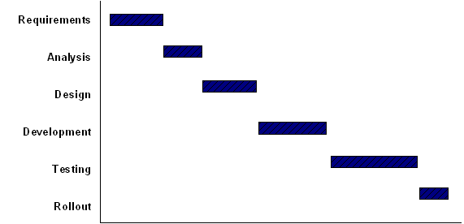
Bar Chart

Slide 75
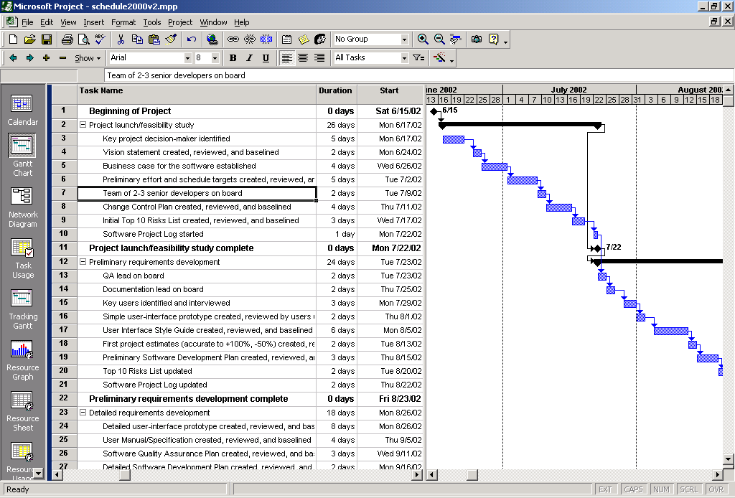
Gantt Chart
Notes:
Implement Gantt Chart By using MS Project

Slide 76
Gantt Chart
Disadvantages
  Does not show interdependencies well
  Does not uncertainty of a given activity (as does PERT)
Advantages
  Easily understood
  Easily created and maintained
Note: Software now shows dependencies among tasks in Gantt charts
  In the “old” days Gantt charts did not show these dependencies, bar charts typically do not

Slide 77
Reducing Project Duration
How can you shorten the schedule?
Via
  Reducing scope (or quality)
  Adding resources
  Concurrency (perform tasks in parallel)
  Substitution of activities

Slide 78
Compression Techniques
Shorten the overall duration of the project
Crashing
    Looks at cost and schedule tradeoffs
    Gain greatest compression with least cost
    Add resources to critical path tasks
    Limit or reduce requirements (scope)
    Changing the sequence of tasks
Fast Tracking
    Overlapping of phases, activities or tasks that would otherwise be sequential
    Involves some risk
    May cause rework

Slide 79
Conclusion [1/3]
Activity plan tells us the order in which we should execute activities and the earliest and latest we can start and finish them
The critical path method and precedence networks can be used to obtain an ideal activity plan

Slide 80
Conclusion [2/3]
The critical path method and precedence networks techniques helps us to identify which activities are critical to meeting a target completion date
In order to manage the project we need to turn the activity plan into schedule that will specify precisely when each activity is scheduled to start and finish

Slide 81
Conclusion [3/3]
Before we can do scheduling, we must consider what resources will be required and whether or not they will be available at appropriate times
The allocation of resources to an activity may be affected by how we view the importance of the task and the risks associated with it

